Slide 1
ONLINE RETAIL DASHBOARD INSIGHTS AND RECOMMENDATIONS
OLUWADAMILOLA PRECIOUS AJIBOLA
16TH AUGUST 2024

Slide 2
Business Performance Overview
Revenue: $8.3M
Total Quantity Sold: 5M units
Key Insights:
Steady performance in revenue generation with a high volume of product movement.
Room to optimize high-margin products or expand into sim

Slide 3
KEY INSIGHTS
Sales Trend Over Time
Graph Analysis:
The sales trend shows fluctuations over the year, peaking during November and December,
likely due to the holiday season.
Noticeable dips in January and August.
Strategic Insight:
Focus marketing efforts on the high-performing months and boost promotions during the off-peak periods.
Consider launching new products or limited-time offers during slower periods to maintain steady sales.

Slide 4
KEY INSIGHTS
Top Products by Sales
Best-Selling Products:
Top 3:
Regency Cakestand 3 Tier ($133K)
White Hanging Heart T-light ($94K)
Jumbo Bag Red Retrospot ($83K)
Strategic Insight:
Capitalize on top-selling products by increasing inventory and expanding the product line with variations.
Consider bundling top-selling products with complementary items to drive upsell opportunities.

Slide 5
KEY INSIGHTS
Revenue by Country
Top Country: United Kingdom (dominates the revenue stream)
Other Major Contributors: Netherlands, EIRE, Germany, France, Australia
Strategic Insight:
Strengthen presence in the UK by exploring local partnerships or exclusive deals.
Explore market expansion opportunities in countries like the Netherlands and Germany where there's established revenue potential but room for growth.

Slide 6
PERFORMANCE METRICS
Revenue Per Customers
Customer Insights:
Customer segmentation shows varying revenue contributions, with top customers generating substantial portions.
Strategic Insight:
Implement customer loyalty programs to incentivize repeat purchases from high-value customers.
Segment marketing efforts by customer revenue tiers to tailor offers and communication effectively.

Slide 7
PERFORMANCE METRICS
Revenue by Weekday
Top Days:
Thursday ($1.91M)
Tuesday ($1.56M)
Wednesday ($1.53M)
Lower Performing Days:
Sunday ($0.78M)
Strategic Insight:
Concentrate high-impact campaigns and promotions on the higher-revenue days to maximize performance.
Introduce offers on Sunday to stimulate demand and drive sales on typically low-performing days.

Slide 8
Strategic Recommendations
New Product Development:
Leverage insights from top-performing products to develop new lines that appeal to similar customer preferences.
Focus on expanding into seasonal product categories to exploit high-revenue months.
Market Expansion:
Double down on UK presence while testing marketing strategies in high-potential countries like the Netherlands and Germany.
Explore cross-border partnerships or tailored promotions for international markets.
Operational Efficiency:
Adjust inventory management to ensure stock availability during peak sales periods (e.g., November/December).
Optimize shipping and distribution channels to accommodate increases in product demand during peak days (Thursdays and Tuesdays).

Slide 9
CONCLUSION
Summary:
The dashboard presents key areas of focus: maximizing revenue on top days, leveraging high-performing products, and exploring international growth.
Implementing strategic recommendations based on these insights can drive both short-term gains and long-term growth.

Slide 10
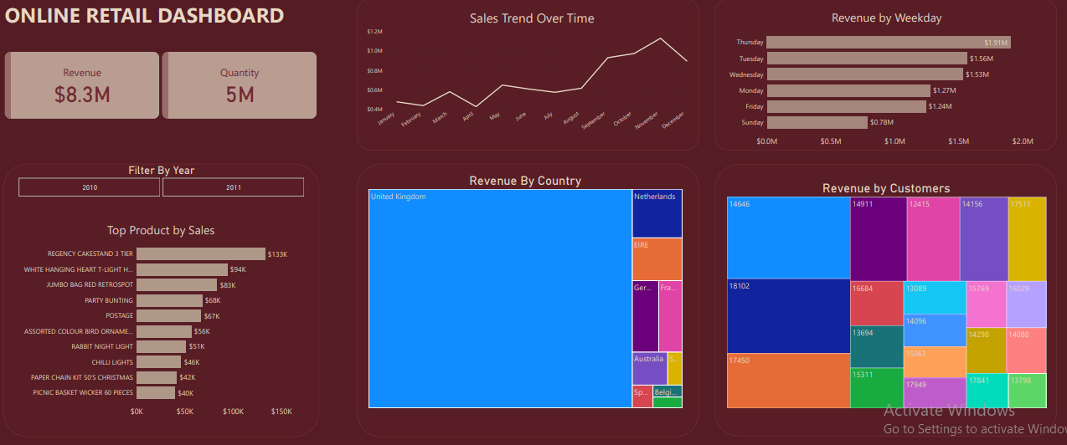

Slide 11
THANK YOU…..

